Slide 1
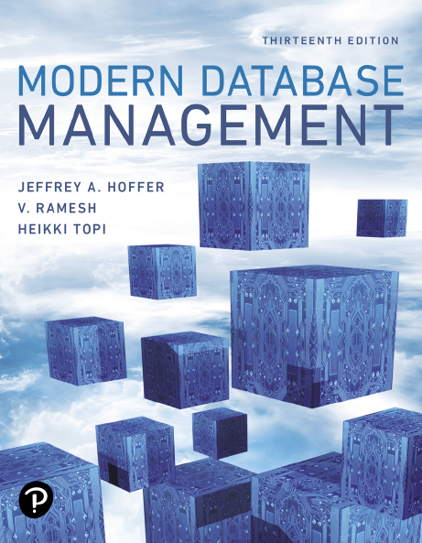
Modern Database Management
Thirteenth Edition
Chapter 6
Advanced S Q L
Copyright © 2019, 2016, 2013 Pearson Education, Inc. All Rights Reserved
Notes:
If this PowerPoint presentation contains mathematical equations, you may need to check that your computer has the following installed:
1) MathType Plugin
2) Math Player (free versions available)
3) NVDA Reader (free versions available)

Slide 2
Learning Objectives
6.1 Define terms
6.2 Write single- and multiple-table queries using S Q L commands
6.3 Define three types of join commands and use S Q L to write these commands
6.4 Write noncorrelated and correlated subqueries and know when to write each
6.5 Write queries to create dynamic and materialized views
6.6 Understand common uses of database triggers and stored procedures
6.7 Discuss the S Q L:2011 and S Q L:2016 standards and explain S Q L enhancements and extensions

Slide 3
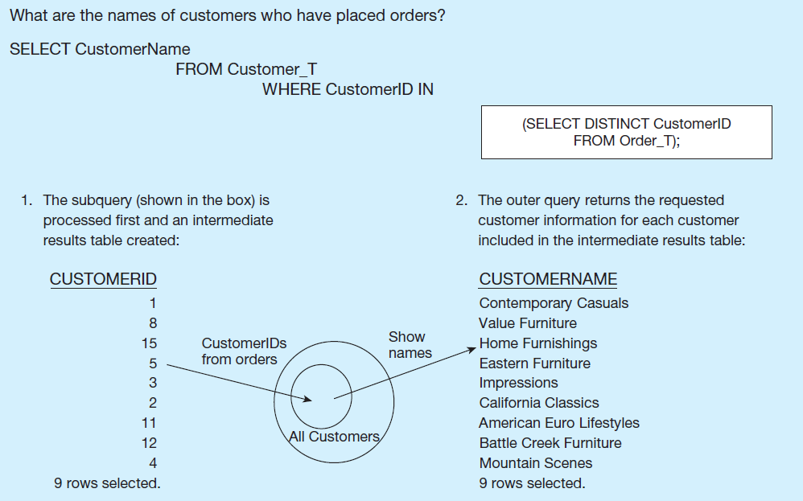
Figure 6-8 Subquery Processing (1 of 2)
a) Processing a noncorrelated subquery

Slide 4
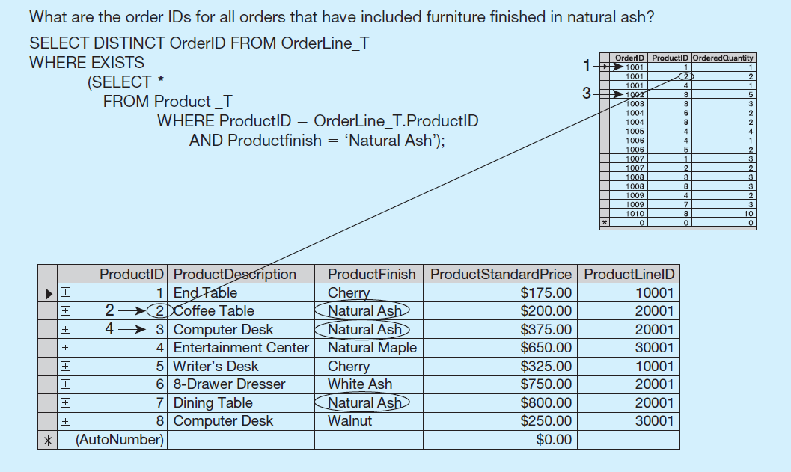
Figure 6-8 Subquery Processing (2 of 2)
b) Processing a correlated subquery
Notes:
In this case the subquery will execute once for each row of the outer query. In this example, the outer query goes through each row of the OrderLine_T table. Each time it gets to a row, that particular row’s product ID is used in the subquery to get the product of that particular order line. There are 17 order line records, so the subquery will execute 17 times, one for each order line record.
So, you can see the difference in behaviors of correlated vs. noncorrelated queries. With a non-correlated query, the inner query executes once, and then the outer query executes. For a correlated subquery, the outer query executes, and for each row of the outer query the inner query will execute once.
The first order ID is selected from OrderLine_T: OrderID 51001.
2. The subquery is evaluated to see if any product in that order has a natural ash finish. Product 2 does, and is part of the order. EXISTS is valued as true and the order ID is added to the result table.
3. The next order ID is selected from OrderLine_T: OrderID 51002.
4. The subquery is evaluated to see if the product ordered has a natural ash finish. It does. EXISTS is valued as true and the order ID is added to the result table.
5. Processing continues through each order ID. Orders 1004, 1005, and 1010 are not included in the result table because they do not include any furniture with a natural ash finish.

Slide 5
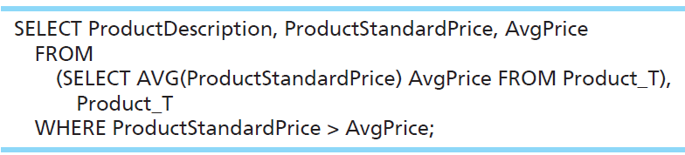
Derived Table (Subquery in the FROM Clause of the Outer Query)
What are the order I Ds for all orders that have included furniture finished in natural ash?
Here, the subquery forms the derived table used in the FROM clause of the outer query. The AvgPrice column from the subquery is used in the SELECT clause of the outer query.
Notes:
Here we have a case where the subquery is in the FROM clause of the outer query. This is often called a “derived table”, because normally you see tables in the FROM clause.
Because aggregate functions cannot be done in the WHERE clause, it is often useful to use subqueries when you want your conditions to include aggregate results.
For example, this query would not have worked:
SELECT ProductDescription, ProductStandardPrice FROM Product_T
WHERE ProductStandardPrice > AVG(ProductStandardPrice);
So instead we do what the slide is showing.
The query:
SELECT ProductDescription, ProductStandardPrice, AvgPrice
FROM
(SELECT AVG(ProductStandardPrice) AvgPrice FROM Product_T),
Product_T
WHERE ProductStandardPrice > AvgPrice;

Slide 6
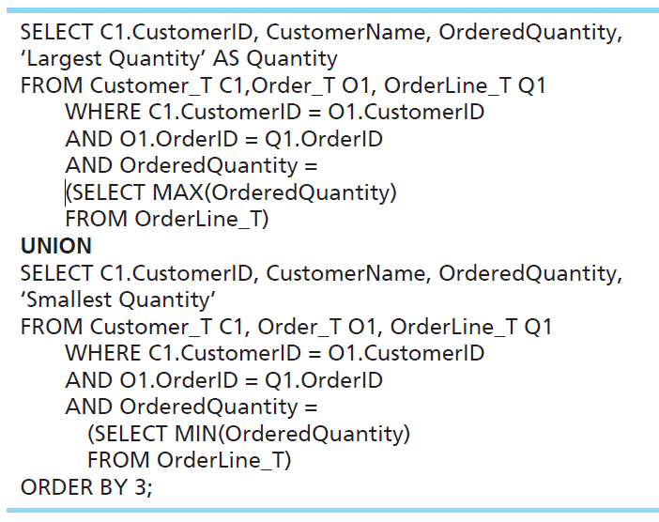
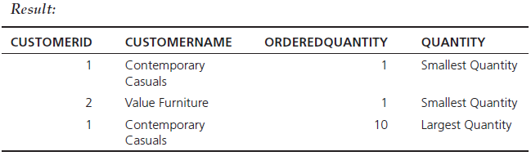
UNION — Combining Queries
Combine the output (union of multiple queries) together into a single result table
With UNION queries, the quantity and data types of the attributes in the SELECT clauses of both queries must be identical.
Notes:
This query determines the customer(s) who has in a given line item purchased the largest quantity of any Pine Valley product and the customer(s) who has in a given line item purchased the smallest quantity and returns the results in one table.
To use the UNION clause, each query involved must output the same number of columns, and they must be UNION compatible. This means that the output from each query for each column should be of compatible data types.
Note: Although these queries involve subqueries, this is not necessary for unions. It just so happens we’re doing it in this example.
In general a UNION is structured like this:
SELECT statement
UNION
SELECT statement
It is possible to use UNION with many different SELECT statements. Here we perform a single UNION operation combining just two of them.
Note another feature of this example. It is possible for the SELECT clause to include literal values in its returned column list. See the words ‘Smallest Quantity’ and ‘Largest Quantity’. These are not values in the tables, but can still be shown in the results.
The query:
SELECT C1.CustomerID, CustomerName, OrderedQuantity,
‘Largest Quantity’ AS Quantity
FROM Customer_T C1,Order_T O1, OrderLine_T Q1
WHERE C1.CustomerID = O1.CustomerID
AND O1.OrderID = Q1.OrderID
AND OrderedQuantity =
(SELECT MAX(OrderedQuantity)
FROM OrderLine_T)
UNION
SELECT C1.CustomerID, CustomerName, OrderedQuantity,
‘Smallest Quantity’
FROM Customer_T C1, Order_T O1, OrderLine_T Q1
WHERE C1.CustomerID = O1.CustomerID
AND O1.OrderID = Q1.OrderID
AND OrderedQuantity =
(SELECT MIN(OrderedQuantity)
FROM OrderLine_
ORDER BY 3;
Result:
CUSTOMERID CUSTOMERNAME ORDEREDQUANTITY QUANTITY
1 Contemporary Casuals 1 Smallest Quantity
2 Value Furniture 1 Smallest Quantity
1 Contemporary Casuals 10 Largest Quantity

Slide 7
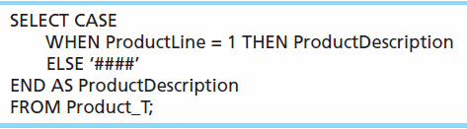
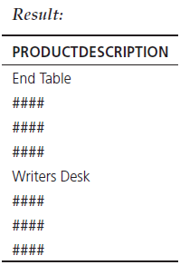
Conditional Expressions Using Case Keyword
A CASE expression acts like an if-then statement. It allows you to choose what will appear in a column of the result set, depending on a condition.
Notes:
SQL does not include an IF-ELSE statement, unlike procedural programming languages. The CASE keyword was introduced to accommodate this need.
The CASE syntax has four possible forms.
The CASE form can be constructed using either an expression that equates to a value or a predicate. The predicate form is based on three-value logic (true, false, don’t know) but allows for more complex operations. The value expression form requires a match to the value expression. So, these are the first two forms.
NULLIF and COALESCE are the keywords associated with the other two forms of the CASE expression.
The query:
SELECT CASE
WHEN ProductLine = 1 THEN ProductDescription
ELSE ‘####’
END AS ProductDescription
FROM Product_T;

Slide 8
More Complicated S Q L Queries
Production databases contain hundreds or even thousands of tables, and tables could include hundreds of columns.
So, sometimes query requirements can be very complex.
Sometimes it’s useful to combine queries, through the use of Views.
If you use a view (which is a query), you could have another query that uses the view as if it were a table.

Slide 9
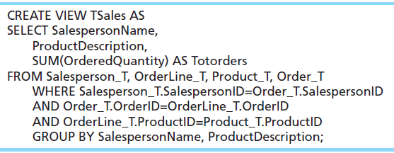
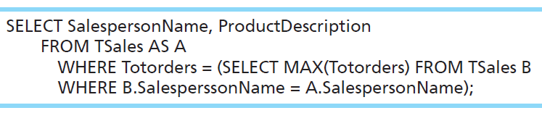
Using a View in Your Query
For each salesperson, list his or her biggest-selling product.
The view:
The query using the view:
Notes:
Here we see an example of creating a view, which will be a permanent object in the database (like a table). Then we use the view as if it is a table. We discuss views in more detail later in this chapter.
The view is called TSales, and consists of an aggregate query involving a join of three tables. TSales, returns the total sales of each product sold by each salesperson.
The query below it uses TSales as if it were a table. Note that this query involves a correlated subquery. This query shows the biggest selling product for each salesperson.
The view:
CREATE VIEW TSales AS
SELECT SalespersonName,
ProductDescription,
SUM(OrderedQuantity) AS Totorders
FROM Salesperson_T, OrderLine_T, Product_T, Order_T
WHERE Salesperson_T.SalespersonID=Order_T.SalespersonID
AND Order_T.OrderID=OrderLine_T.OrderID
AND OrderLine_T.ProductID=Product_T.ProductID
GROUP BY SalespersonName, ProductDescription;
The query using the view:
SELECT SalespersonName, ProductDescription
FROM TSales AS A
WHERE Totorders = (SELECT MAX(Totorders) FROM TSales B
WHERE B.SalesperssonName = A.SalespersonName);

Slide 10
Tips for Developing Queries
Be familiar with the data model (entities and relationships)
Understand the desired results
Know the attributes desired in results
Identify the entities that contain desired attributes
Review E R D
Construct a WHERE equality for each link
Fine tune with GROUP BY and HAVING clauses if needed
Consider the effect on unusual data
Notes:
It is important to test your query against a set of test data that includes unusual data, missing data, impossible values, etc.

Slide 11
Query Efficiency Considerations
Instead of SELECT *, identify the specific attributes in the SELECT clause; this helps reduce network traffic of result set
Limit the number of subqueries; try to make everything done in a single query if possible
If data is to be used many times, make a separate query and store it as a view
Notes:
Subqueries can be very useful, but can also cause computational overload. This is especially true for correlated subqueries. Suppose for example, you had a correlated subquery where the outer query was processing through 10,000 rows. This means the subquery would execute 10,000 times! So, in effect, that one overall query involves 10,001 real queries.
This is another reason it is important to test your queries. Not only must they be able to execute, but they should produce valid results, in a reasonable amount of time.

Slide 12
Guidelines for Better Query Design (1 of 2)
Understand how indexes are used in query processing
Keep optimizer statistics up to date
Use compatible data types for fields and literals
Write simple queries
Break complex queries into multiple simple parts
Don’t nest one query inside another query
Don’t combine a query with itself (if possible avoid self-joins)

Slide 13
Guidelines for Better Query Design (2 of 2)
Create temporary tables for groups of queries
Combine update operations
Retrieve only the data you need
Don’t have the D B M S sort without an index
Learn!
Consider the total query processing time for ad hoc queries
Notes:
All options are not available with every DBMS, and each DBMS has unique options due to its underlying design. You should refer to reference manuals for your DBMS to know which specific tuning options are available to you.

Slide 14
Using and Defining Views
Dynamic View
A “virtual table” created dynamically upon request by a user
No data actually stored; instead data from base table made available to user
Based on S Q L SELECT statement on base tables or other views
Materialized View
Copy or replication of data, data actually stored
Must be refreshed periodically to match corresponding base tables
Notes:
Views provide users controlled access to tables. The term “base table” refers to the table containing the raw data.
So, a dynamic view is a “virtual table”, whereas a materialized view is an actual table generated by copying data from the base tables queried.

Slide 15
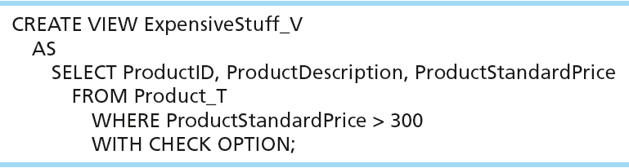
A Sample Create View Command
View has a name
View is based on a SELECT statement
CHECK_OPTION works only for updateable views and prevents updates that would create rows not included in the view

Slide 16
Advantages of Dynamic Views (1 of 2)
Simplify query commands
Assist with data security
Enhance programming productivity
Contain most current base table data
Use little storage space
Provide customized view for user
Establish physical data independence
Notes:
Note: Although views assist with data security, don't rely solely on views for security. There are more important security measures.

Slide 17
Advantages of Dynamic Views (2 of 2)
Use processing time each time view is referenced
May or may not be directly updateable
As with all S Q L constructs, you should use views with discretion

Slide 18
Routines and Triggers
Routines
Program modules that execute on demand
Functions
routines that return values and take input parameters
Procedures
routines that do not return values and can take input or output parameters
Triggers
routines that execute in response to a database event (INSERT, UPDATE, or DELETE)

Slide 19
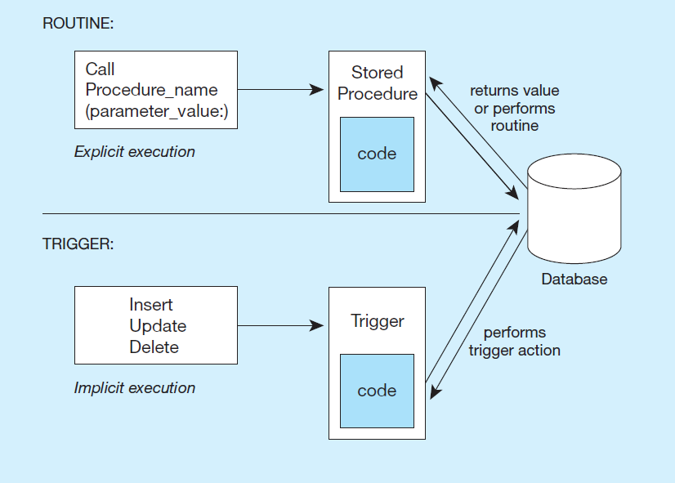
Figure 6-13 Triggers Contrasted with Stored Procedures (Based on Mullins 1995)
Procedures and functions are called explicitly. Triggers are event-driven.
Notes:
Procedures and Functions are called explicitly by the user of the database (for example an application program). When calling a procedure or function, you may pass it parameters. Functions, unlike procedures, will actually return a value. In both cases, there could be several queries or updates done to the database.
Triggers are not called explicitly. Instead, they are invoked as a result of some sort of database action, such as inserting a new record, modifying an existing record, or deleting a record. They could also be invoked as a result of a DDL statement to ALTER a table.

Slide 20
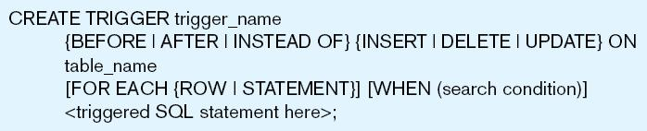
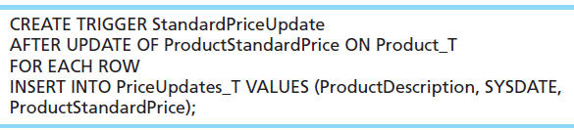
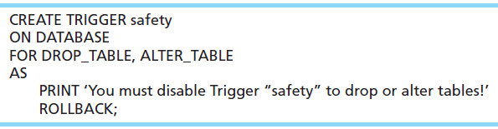
Figure 6-14 Simplified Trigger Syntax, S Q L:2008
Example D M L trigger
Example D D L trigger
Notes:
Triggers may occur either before, after, or instead of the statement that aroused the trigger is executed. DML triggers may occur on INSERT, UPDATE, or DELETE commands.
Question: Remember what DML stands for?
Answer: Data Manipulation Language.
Question: Remember what DDL stands for?
Answer: Data Definition Language
This sample DML trigger will execute after an update of the ProductStandardPrice column of the Product_T table. It will add a new row to the PriceUpdates_T table, and use the new values of the product description and price (from the update) for this new row.
DML trigger:
CREATE TRIGGER StandardPriceUpdate
AFTER UPDATE OF ProductStandardPrice ON Product_T
FOR EACH ROW
INSERT INTO PriceUpdates_T VALUES (ProductDescription, SYSDATE,
ProductStandardPrice);
DDL triggers are generally most useful to database administrators.
DDL trigger::
CREATE TRIGGER safety
ON DATABASE
FOR DROP_TABLE, ALTER_TABLE
AS
PRINT ‘You must disable Trigger “safety” to drop or alter tables!’
ROLLBACK;

Slide 21
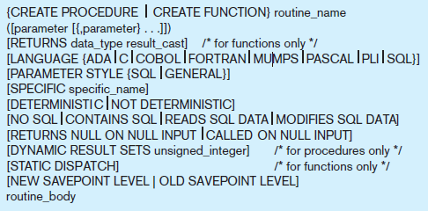
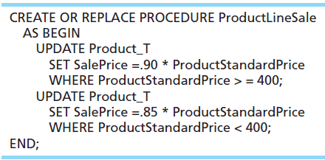

Figure 6-15 Syntax for Creating a Routine, S Q L:2011
Example D D L trigger
Calling the procedure
Notes:
The stored procedure code:
CREATE OR REPLACE PROCEDURE ProductLineSale
AS BEGIN
UPDATE Product_T
SET SalePrice =.90 * ProductStandardPrice
WHERE ProductStandardPrice > = 400;
UPDATE Product_T
SET SalePrice =.85 * ProductStandardPrice
WHERE ProductStandardPrice < 400;
END;

Slide 22
Data Dictionary Facilities
System tables that store metadata
Users usually can view some of these tables
Users are restricted from updating them
Examples in Oracle 12c
D B A_TABLES – descriptions of tables
D B A_USERS – information about the users of the system
Examples in Microsoft S Q L Server 2016
sys.columns – table and column definitions
sys.indexes – table index information
Notes:
All of these tables and views are used internally by the DBMS. But you can also query them. For example, you could find the owners of a company’s tables. Here is an example if PVF’s database was stored in an Oracle DBMS:
SELECT OWNER, TABLE_NAME FROM DBA_TABLES WHERE TABLE_NAME = ‘PRODUCT_T’;

Slide 23
S Q L Enhancements/Extensions (1 of 2)
User-defined data types (U D T)
Subclasses of standard types or an object type
Analytical functions (for O L A P)
CEILING, FLOOR, S Q R T, RANK, DENSE_RANK, ROLLUP, CUBE, SAMPLE,
WINDOW – improved numerical analysis capabilities
New Data Types
BIG INT, MULTISET (collection), X M L
CREATE TABLE LIKE
create a new table similar to an existing one
MERGE

Slide 24
S Q L Enhancements/Extensions (2 of 2)
Programming extensions
Persistent Stored Modules (S Q L/P S M)
Capability to create and drop code modules
New statements: CASE, IF, LOOP, FOR, WHILE, etc.
Makes S Q L into a procedural language
Oracle has propriety version called P L/S Q L, and Microsoft S Q L Server has Transact/S Q L

Slide 25

Copyright

